Slide 1

Handwritten CAPTCHA for Authentication
Batch No: B-02 Project Guide:
M.Uma Maheswari (164G1A05B4) Mr. Lingam Suman _{MTech}
H.Sai Lavanya (164G1A0587) Assistant Professor`
C.Pavani (164G1A0565)
C.Vamsi Krishna (164G1A05B6)
Srinivasa Ramanujan Institute of Technology
Department of Computer Science & Engineering

Slide 2
Abstract
A Turing test is a method of inquiry for determining whether or not a computer is capable of thinking like a human being.
This test is useful for web based application in the form of CAPTCHA (Completely Automated Public Turing Test to tell Computers and Humans Apart) to prevent from automated access and the harms caused by the bots.
During the survey, it has been observed that every form submission websites have different forms of CAPTCHA to secure the server, but the techniques proposed so far are lacking security.

Slide 3
The motive of this proposed CAPTCHA is to review the existing CAPTCHA techniques and provide best level of security using handwritten CAPTCHA that is very difficult to be cracked and able to replace the existing systems.
We take the handwritten equation from the user in the form of image and at the same time we are not allowing any bots to submit the equation and hence, we validate the user submitted handwritten equation using CNN.
Convolutional Neural Network is primarily used in object recognition by taking images as input and then classifying them .
The level of complexity which has been merged in the proposed CAPTCHA may let the human to solve it but it becomes quite difficult to bots.

Slide 4
Requirements
Hardware Requirements:
PC with minimum configuration of i3 Processor and 4GB RAM.
Operating System: Windows 7 and above
Software Requirements:
Google Colaboratory
Sublime Text Editor

Slide 5
Existing System
During the survey, it has been observed that every form submission websites have different forms of CAPTCHA to secure the server but the techniques proposed so far are lacking security.
Some types of CAPTCHA are often simple to recognize but they get cracked by intruders.
Some others types of CAPTCHA are much difficult to solve by the human.

Slide 6
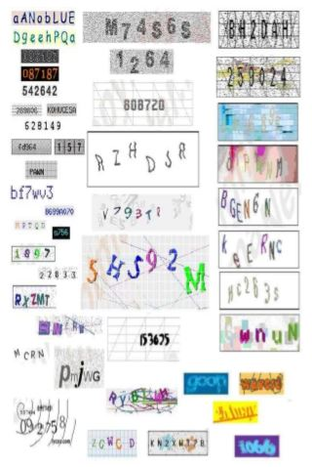

Slide 7
Proposed System
We present the application which focuses on preventing bots from automatically submitting forms with SPAM or other unwanted content.
Our goal is to introduce "Handwritten CAPTCHA" as an automated Turing test that is designed to allow humans to pass with little effort but where the bots fail.

Slide 8
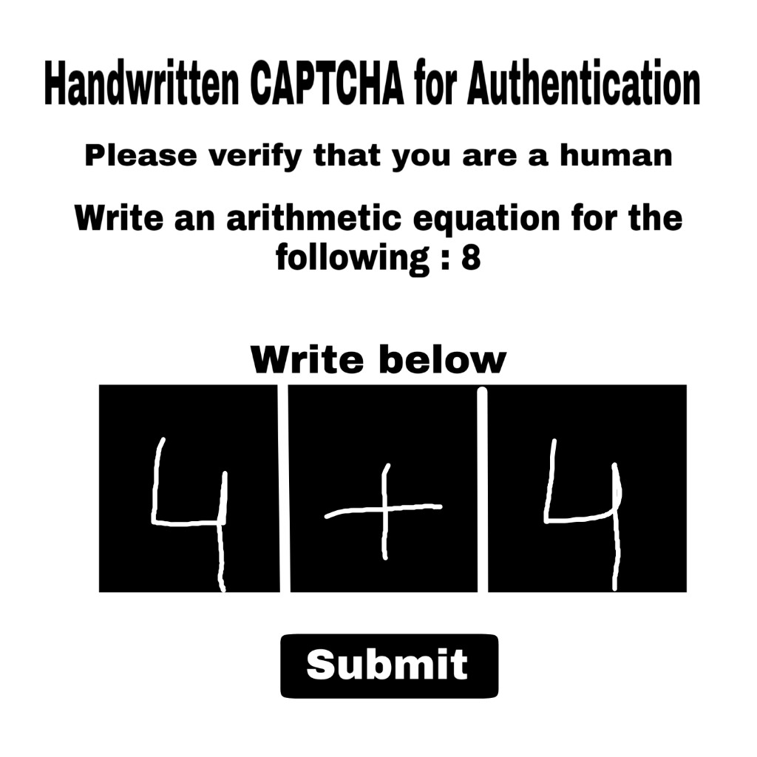

Slide 9
Problem Definition
CAPTCHA-Completely Automated Public Turing test to tell Computers and Humans Apart is a test that can distinguish human users from computer/robot.
We are developing the most secure CAPTCHA for authentication purpose that is very difficult to crack by the intruders.

Slide 10
Planning
Task | Date
Collecting and working with Dataset. | 05-02-2020 to 09-02-2020
Designing the web page. | 10-02-2020 to 19-02-2020
Training, generating the model and testing (For recognizing the digits and operators). | 20-02-2020 to 28-02-2020
Integrating web page with generated machine learning model for solving CAPTCHA. | 29-02-2020 to 10-03-2020
Testing and Documentation. | 11-03-2020 to 23-03-2020

Slide 11
Literature Survey
1. “A Survey on Breaking Technique of Text-Based CAPTCHA”
This paper talks about developments in the text-based CAPTCHA breaking field.
This defines a framework mainly consists of preprocessing, segmentation, combination, recognition, post processing, and other modules.
The segmentation methods based on individual characters segment a CAPTCHA image to individual characters. For individual characters, we can use segmentation methods based on character projection and connected component.

Slide 12
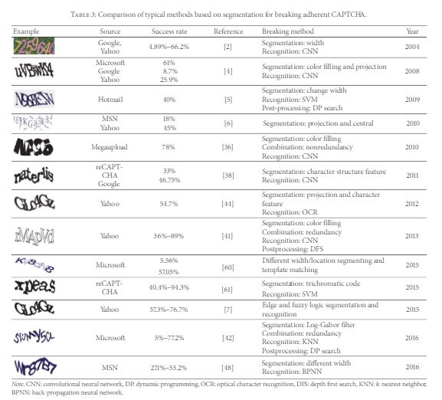

Slide 13
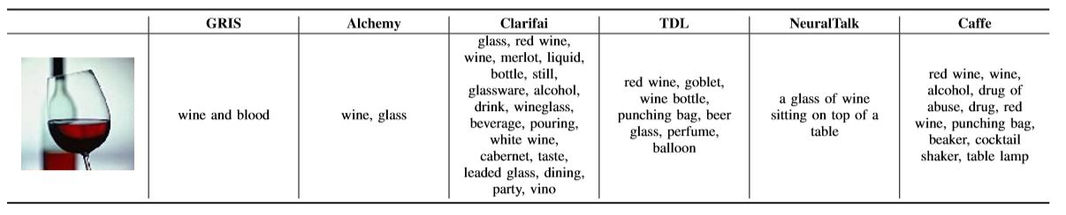
2.I Am Robot:(Deep)Learning to Break Semantic Image CAPTCHAs
From this paper we concluded that by using some of the methods like GRIS, Image Annotation( Clarifai, Alchemi, TDL, Neural Talk, Caffe) we can solve the image based CAPTCHA.

Slide 14
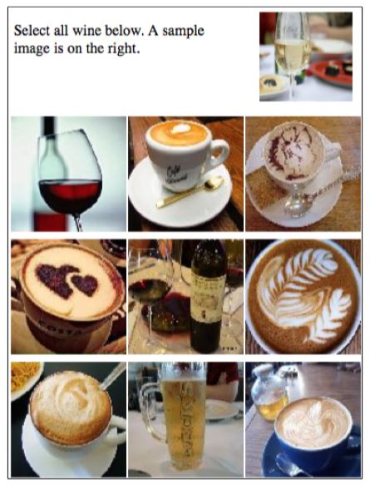

Slide 15
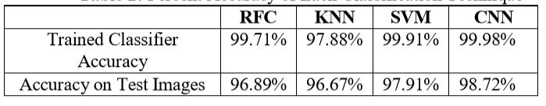
3. “Handwritten Digit Recognition Using Deep Learning”
In this report, he compared the results of some of the most widely used Machine Learning Algorithms like SVM, KNN and RFC and with Deep Learning algorithm like MLP and CNN using Keras with Theano and Tensorflow.
Using these, he was able to get the accuracy of 98.70% using CNN (Keras+Theano) as compared to 97.91% using SVM, 96.67% using KNN, 96.89% using RFC .

Slide 16
References
1. Chen, Jun & Luo, Xiangyang & Guo, Yanqing & Zhang, Yi & Gong, Daofu. (2017). A Survey on Breaking Technique of Text-Based CAPTCHA. Security and Communication Networks. 2017. 1-15. 10.1155/2017/6898617. “A Survey on Breaking Technique of Text-Based CAPTCHA”
2. Suphannee Sivakorn, Iasonas Polakis and Angelos D. Keromytis Department of Computer Science Columbia University, New York, USA “Am Robot:(Deep)Learning to Break Semantic Image CAPTCHAs”
3. Anuj Dutt, Aashi Dutt .International Journal of Advanced Research in Computer Engineering & Technology (IJARCET) July 2017, ISSN: 2278 – 1323 . “Handwritten Digit Recognition Using Deep Learning”

Slide 17
Review 1 Challenges
Change the Title of the Project.
Application of the Project.

Slide 18
Thank you
Queries
?

